Slide 1
Internet Key Exchange
Nathan Bellew

Slide 2
Overview
History of IKE
Why IKE is used
What is IKE
IKE Phases
Mode of Operation
Authentication Methods
Session Keys
ISAKMP/IKE

Slide 3
History of IKE
Diffie-Hellman
Authentication
Photuris
Key Security
Oakley
Secure Key Exchange
IPSec
IP Security
Security Framework
Internet Security Association and Key Management (ISAKMP)
Secure Key Exchange Mechanism (SKEME)
Secure Key Exchange
Internet Key Exchange

Slide 4


Why IKE
ISAKMP -> Authentication and Key Exchange Framework
Oakley -> Key Exchange Modes
SKEME -> anonymity, reputability, and key refreshment
Each is good but we needed All!
SKEME
ISAKMP
Internet Key Exchange
Oakley

Slide 5

IKE Phases
Only 2 Phases?
Phase 1: Mutual Authenticaiton and Session Keys = IKE SA
Phase 2: Create Multiple Associations between entities = ESP or AH SA
IKE – Internet Key Exchange
SA – Security Association
ESP – Encapsulating Security Payload
AH – Authentication Header

Slide 6
Phase 1 Summary
Authenticate IPSec Peers
Secure Channel between Peers

Slide 7
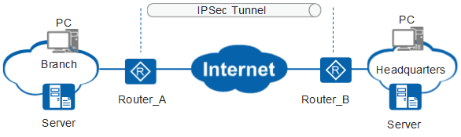
Phase 1 Steps
Choose a Mode
Aggressive or Main
Authenticate and Protect IPSec Peers
Create Shared Secret Keys (Diffie-Hellman)
Establish secure tunnel for Phase 2 Parameters

Slide 8


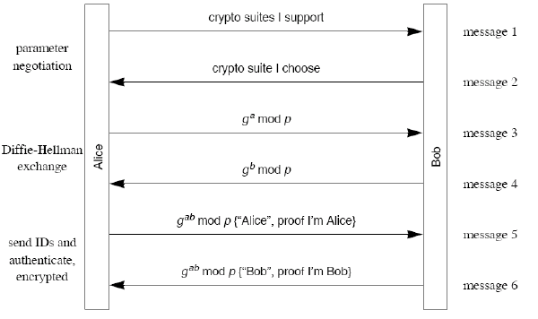
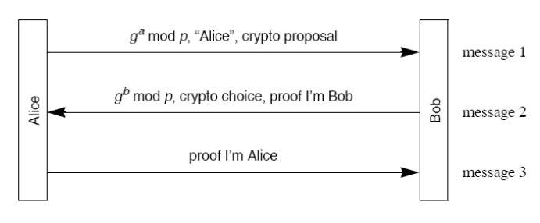
Modes of Phase 1
Main Mode
6 Messages
Aggressive Mode
3 Messages

Slide 9

IKE Authentication Methods
Original Public Key Encryption
Revised Public Key Encryption
Public Key Signature
Pre-shared secret Key

Slide 10
Diffie Hellman
Talk abou Parameters and look in the book

Slide 11
Proof of Identity

Slide 12
IKE Phase 2

Slide 13
What is a Message

